Slide 1
Recipe Box

Slide 2
The Problem
Recipes kept on paper can get lost, stolen, or destroyed
Paper recipes are hard to share
Paper recipes sizes are limited in space

Slide 3
The Solution
Electronic databases provide integrity and availability
Search and share features significantly improves recipe collection
Review system can introduce new recipes or ideas

Slide 4
Design/Requirements
Waterfall development method
ASP.Net Webapp following MVC (Model View Controller) design
Integrates with SQL Server
Hosted on Azure Cloud

Slide 5
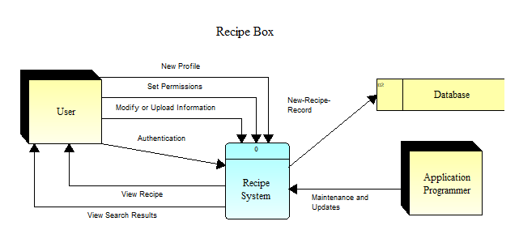
Diagram

Slide 6
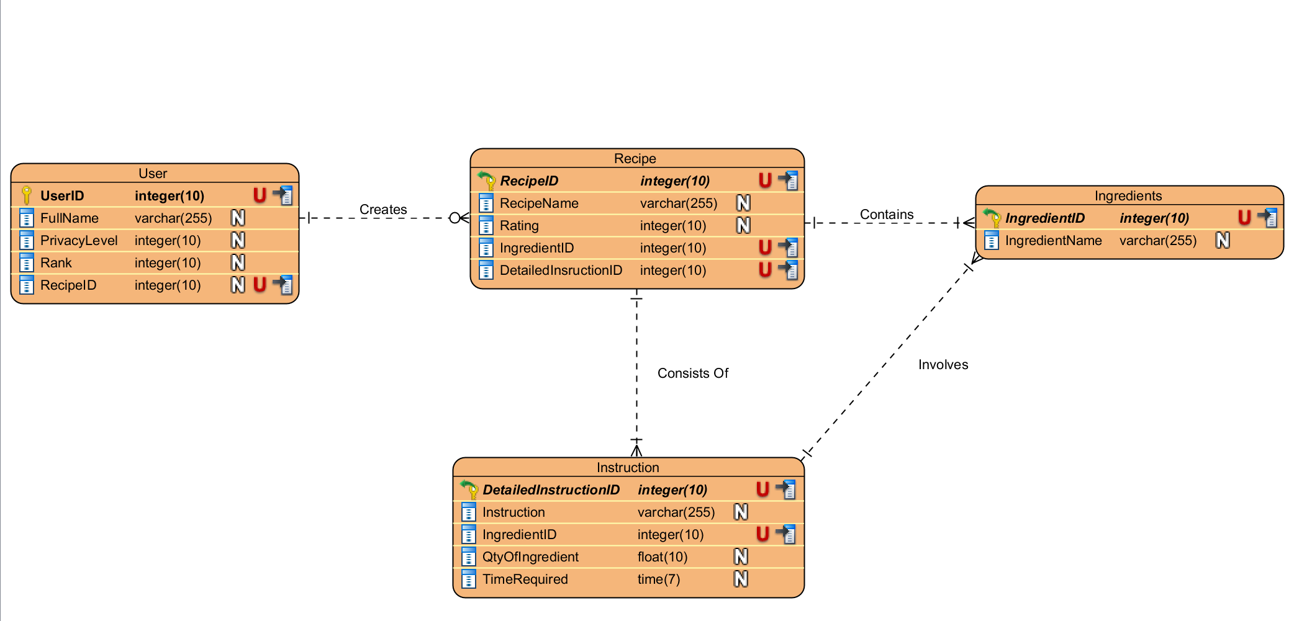
Database

Slide 7
Additional Information
Minimal requirements
Easily tested
Maintenance is accessible
Mobile options are upcoming

Slide 8
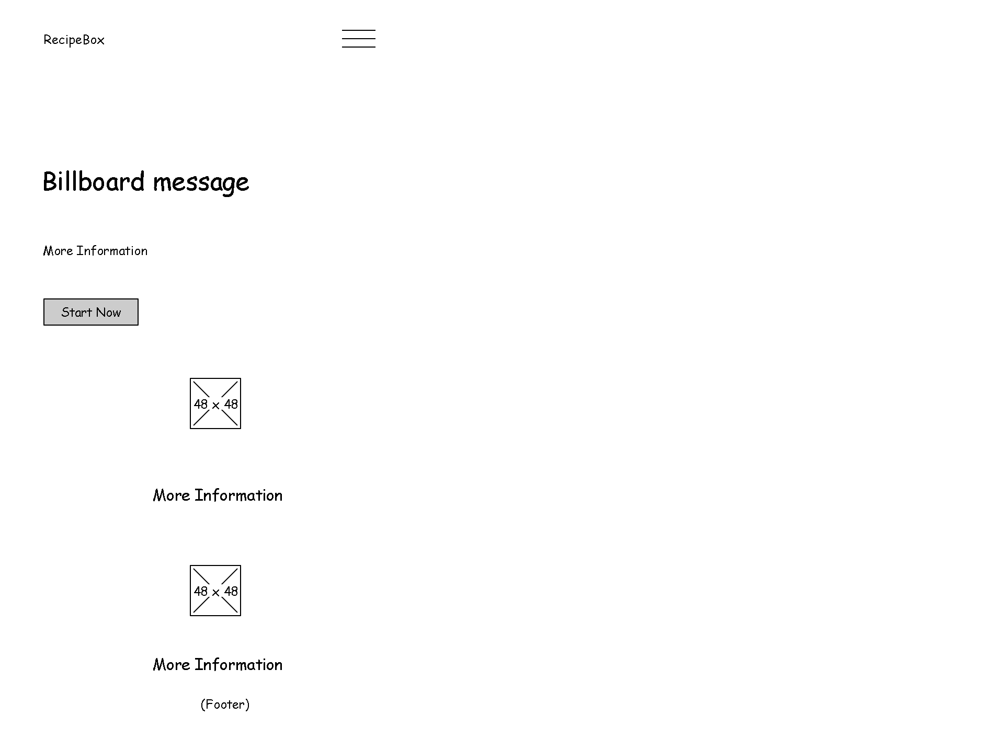
Mobile Wireframe

Slide 9
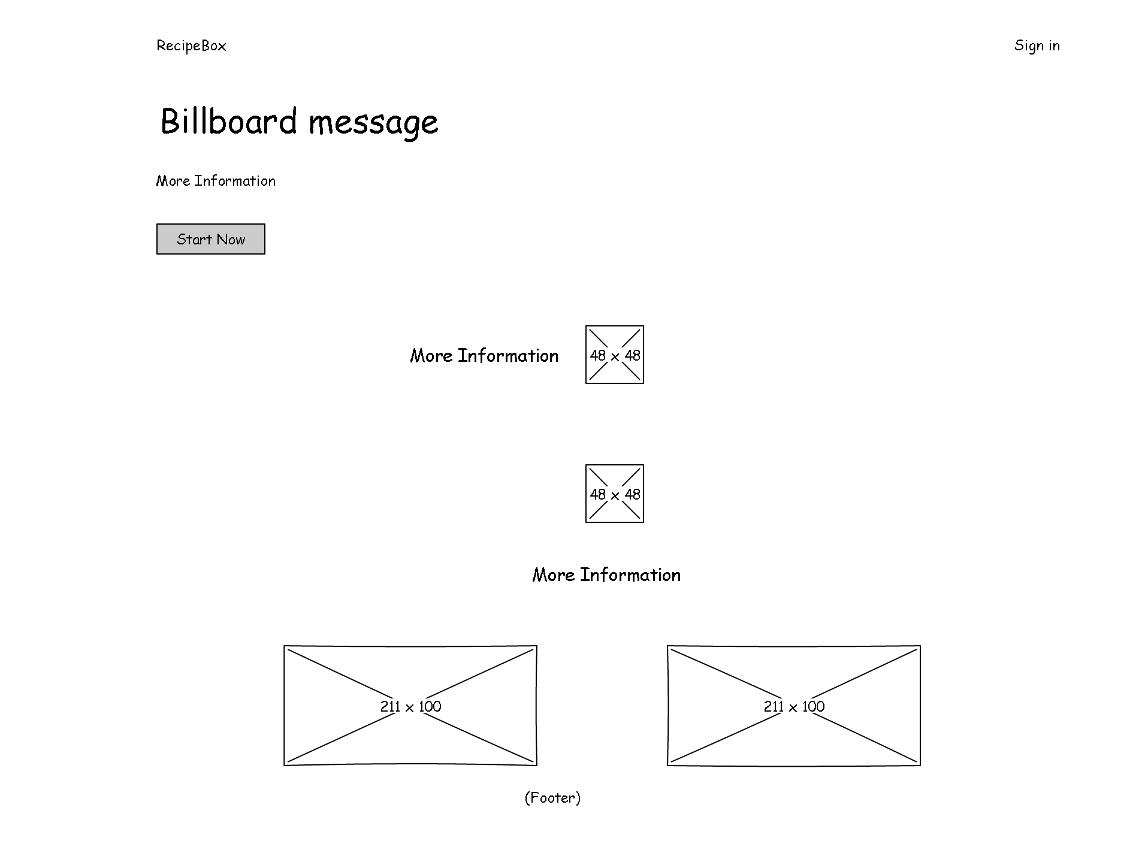
Tablet and Desktop Wireframe

Slide 10
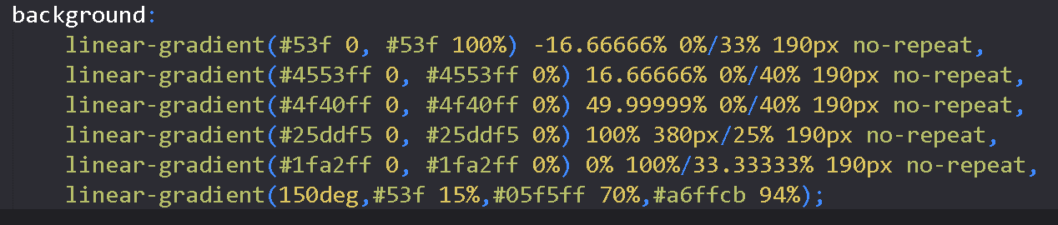
Gradient Theme

Slide 11
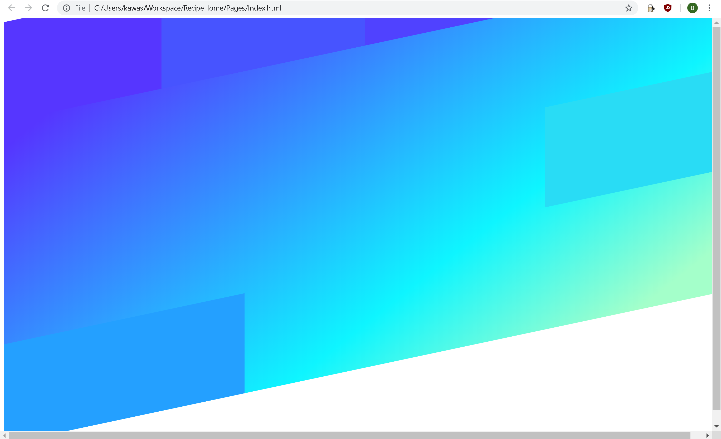
In Browser

Slide 12
Features
Meal Planning and Grocery List
Cross off steps/ingredients
Leave notes/ratings
Search by history, rating, category
Print, email, sharing
Timer
Pin recipes to quick access bar

Slide 13
Similar Apps
BigOven
RecipeScan
25/month
Paprika
$5

Slide 14
Requirements
User Authentication
List of all user’s recipes
CRUD operations with recipes
Publish option for recipes that will be viewable by all users
Review ability

Slide 15

Implementation
Completed
Users are implemented
DAL is separated
Design is modular
Modify successful login to redirect to user’s recipe list
Backlog
Users have CRUD capability
Users can publish their own recipes
Users can submit reviews on recipes
Style is updated
Pagination is implemented
Future Updates
Text-to-speech integration

Slide 16
Planning that went right/wrong
Right
HTML/CSS styling
Wrong
Identity
Facebook Integration
Entity Framework
View Models
CRUD operations

Slide 17
Requirement | Passed Test
Login Redirects to correct page | Yes
Facebook authenticates | Yes
Displayed Recipes | Yes
Create Recipes | No
Update Recipes | No
Delete Recipes | No
Publish page displays recipes | No
Publish button marks recipe | No
Pages display Pagination | No
Reviews can be created | No
Reviews can be read | No

